Slide 1




ETHERNET
FUNDAMENTALS
Networking Basics
Version 3.0
Cisco Regional Networking Academy

Slide 2
Objectives
Describe the basics of Ethernet technology.
Explain naming rules of Ethernet technology.
Define how Ethernet and the OSI model interact.
Describe the Ethernet framing process and frame structure.
List Ethernet frame field names and purposes.
Identify the characteristics of CSMA/CD.
Describe the key aspects of Ethernet timing, interframe spacing and backoff time after a collision.
Define Ethernet errors and collisions.
Explain the concept of auto-negotiation in relation to speed and duplex.

Slide 3
Table of Content
1 | Ethernet Fundamentals
2 | Ethernet Operarion

Slide 4

ETHERNET FUNDAMENTALS

Slide 5
Introduction to Ethernet
In 1970’s
  CSMA/CD developed at the University of Hawaii
In 1980’s
  First experimental Ethernet system at Xerox PARC
In 1985, IEEE 802.3 released
Digital Equipment, Intel, and Xerox jointly develop & release Ethernet Version 2.0
    Substantially compatible with IEEE 802.3
In 1995, IEEE announced a standard for a 100-Mbps Ethernet. This was followed by standards for Gigabit ethernet in 1998 and 1999.
Notes:
Most of the traffic on the Internet originates and ends with Ethernet connections. From its beginning in the 1970s, Ethernet has evolved to meet the increasing demand for high speed LANs. When a new media was produced, such as optical fiber, Ethernet adapted to take advantage of the superior bandwidth and low error rate that fiber offers. Now, the same protocol that transported data at 3 Mbps in 1973 is carrying data at 10 Gbps.
The success of Ethernet is due to the following factors:
Simplicity and ease of maintenance
Ability to incorporate new technologies
Reliability
Low cost of installation and upgrade
With the introduction of Gigabit Ethernet, what started as a LAN technology now extends out to distances that make Ethernet a metropolitan-area network (MAN) and wide-area network (WAN) standard.
The original idea for Ethernet grew out of the problem of allowing two or more hosts to use the same medium and prevent the signals from interfering with each other. This problem of multiple user access to a shared medium was studied in the early 1970s at the University of Hawaii. A system called Alohanet was developed to allow various stations on the Hawaiian Islands structured access to the shared radio frequency band in the atmosphere. This work later formed the basis for the Ethernet access method known as CSMA/CD.
The first LAN in the world was the original version of Ethernet. Robert Metcalfe and his coworkers at Xerox designed it more than thirty years ago. The first Ethernet standard was published in 1980 by a consortium of Digital Equipment Company, Intel, and Xerox (DIX). Metcalfe wanted Ethernet to be a shared standard from which everyone could benefit, so it was released as an open standard. The first products developed using the Ethernet standard were sold during the early 1980s. Ethernet transmitted at up to 10 Mbps over thick coaxial cable up to a distance of two kilometers. This type of coaxial cable was referred to as thicknet and was about the width of a small finger.
In 1985, the Institute of Electrical and Electronics Engineers (IEEE) standards committee for Local and Metropolitan Networks published standards for LANs. These standards start with the number 802. The standard for Ethernet is 802.3. The IEEE wanted to make sure that its standards were compatible with the International Standards Organization (ISO)/OSI model. To do this, the IEEE 802.3 standard had to address the needs of Layer 1 and the lower portion of Layer 2 of the OSI model. As a result, some small modifications to the original Ethernet standard were made in 802.3.
The differences between the two standards were so minor that any Ethernet network interface card (NIC) can transmit and receive both Ethernet and 802.3 frames. Essentially, Ethernet and IEEE 802.3 are the same standards.
The 10-Mbps bandwidth of Ethernet was more than enough for the slow personal computers (PCs) of the 1980s. By the early 1990s PCs became much faster, file sizes increased, and data flow bottlenecks were occurring. Most were caused by the low availability of bandwidth. In 1995, IEEE announced a standard for a 100-Mbps Ethernet. This was followed by standards for gigabit per second (Gbps, 1 billion bits per second) Ethernet in 1998 and 1999.
All the standards are essentially compatible with the original Ethernet standard. An Ethernet frame could leave an older coax 10-Mbps NIC in a PC, be placed onto a 10-Gbps Ethernet fiber link, and end up at a 100-Mbps NIC. As long as the packet stays on Ethernet networks it is not changed. For this reason Ethernet is considered very scalable. The bandwidth of the network could be increased many times without changing the underlying Ethernet technology.
The original Ethernet standard has been amended a number of times in order to manage new transmission media and higher transmission rates. These amendments provide standards for the emerging technologies and maintain compatibility between Ethernet variations.
Web Links
Ethernet Basics
http://howto.lycos.com/lycos/step/ 1,,26166+25845+ 18041,00.html

Slide 6
The success of Ethernet is due to the following factors
Simplicity and ease of maintenance
Ability to incorporate new technologies
Reliability
Low cost of installation and upgrade

Slide 7
IEEE Ethernet naming rules
10Base-2: 50Ω Thin cable, 185m.
10Base-5: 50Ω Thick cable, 500m.
10Base-T: 100Ω UTP cable, 100m.
10Base-F: Fiber optic cable, 1000m.
100Base-TX: 100Ω UTP/STP cable, 100m.
100Base-T4: 100Ω UTP (4p) cable, 100m.
100Base-FX: Fiber optic cable, 400m.
1000Base-T: 100Ω UTP/STP cable, 100m.
Notes:
Ethernet is not one networking technology, but a family of networking technologies that includes Legacy, Fast Ethernet, and Gigabit Ethernet. Ethernet speeds can be 10, 100, 1000, or 10,000 Mbps. The basic frame format and the IEEE sublayers of OSI Layers 1 and 2 remain consistent across all forms of Ethernet. When Ethernet needs to be expanded to add a new medium or capability, the IEEE issues a new supplement to the 802.3 standard. The new supplements are given a one or two letter designation such as 802.3u. An abbreviated description (called an identifier) is also assigned to the supplement.
The abbreviated description consists of:
A number indicating the number of Mbps transmitted.
The word base, indicating that baseband signaling is used.
One or more letters of the alphabet indicating the type of medium used (F= fiber optical cable, T = copper unshielded twisted pair).
Ethernet relies on baseband signaling, which uses the entire bandwidth of the transmission medium. The data signal is transmitted directly over the transmission medium. In broadband signaling, not used by Ethernet, the data signal is never placed directly on the transmission medium. An analog signal (carrier signal) is modulated by the data signal and the modulated carrier signal is transmitted. Radio broadcasts and cable TV use broadband signaling.
The IEEE cannot force manufacturers of networking equipment to fully comply with all the particulars of any standard. The IEEE hopes to achieve the following:
Supply the engineering information necessary to build devices that comply with Ethernet standards.
Promote innovation by manufacturers.

Slide 8
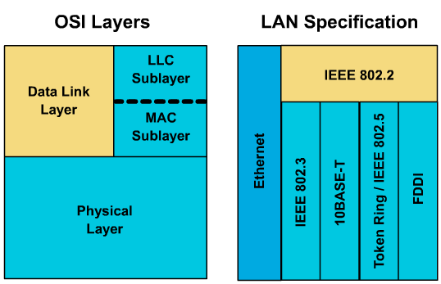
Ethernet and the OSI model
Notes:
Ethernet operates in two areas of the OSI model, the lower half of the data link layer, known as the MAC sublayer and the physical layer.
Figure maps a variety of Ethernet technologies to the lower half of OSI Layer 2 and all of Layer 1. Ethernet at Layer 1 involves interfacing with media, signals, bit streams that travel on the media, components that put signals on media, and various topologies. Ethernet Layer 1 performs a key role in the communication that takes place between devices, but each of its functions has limitations. Layer 2 addresses these limitations.
Data link sublayers contribute significantly to technology compatibility and computer communication. The MAC sublayer is concerned with the physical components that will be used to communicate the information. The Logical Link Control (LLC) sublayer remains relatively independent of the physical equipment that will be used for the communication process.

Slide 9
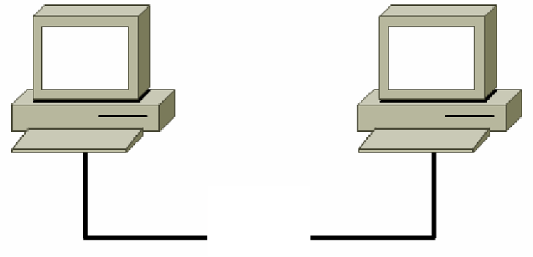

A Repeater
Standards guarantee minimum bandwidth and operability by specifying the maximum number of stations per segment, maximum segment length, maximum number of repeaters between stations, etc.
Stations separated by repeaters are within the same collision domain. Stations separated by bridges or routers are in different collision domains.
Notes:
To move data between one Ethernet station and another, the data often passes through a repeater. All other stations in the same collision domain see traffic that passes through a repeater. A collision domain is then a shared resource. Problems originating in one part of the collision domain will usually impact the entire collision domain.
A repeater is responsible for forwarding all traffic to all other ports. Traffic received by a repeater is never sent out the originating port. Any signal detected by a repeater will be forwarded. If the signal is degraded through attenuation or noise, the repeater will attempt to reconstruct and regenerate the signal.
Standards guarantee minimum bandwidth and operability by specifying the maximum number of stations per segment, maximum segment length, maximum number of repeaters between stations, etc. Stations separated by repeaters are within the same collision domain. Stations separated by bridges or routers are in different collision domains.

Slide 10
Layer 1 vs Layer 2
Layer 1 cannot organize streams of bits.
Layer 2 uses framing to organize or group the bits.
Layer 1 cannot name or identify computers.
Layer 2 uses an addressing process to identify computers.
Layer 1 cannot communicate with the upper-level layers.
Layer 2 uses Logical Link Control (LLC) to communicate with the upper-level layers.
Layer 1 cannot decide which computer will transmit binary data.
Layer 2 uses Media Access Control (MAC) to decide which computer will transmit.

Slide 11
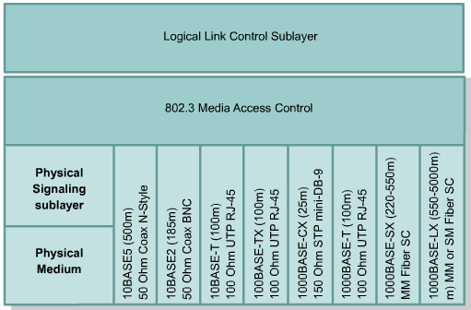
Ethernet and the OSI mode

Slide 12
Naming
Every computer has a unique way of identifying itself : MAC address or physical address.
The physical address is located on the Network Interface Card (NIC).
MAC addresses have no structure, and are considered flat address spaces. MAC addresses are sometimes referred to as burned-in addresses (BIAs) because they are burned into read-only memory (ROM) and are copied into random-access memory (RAM) when the NIC initializes.
0000.0c12.3456 or 00-00-0c-12-34-56.
Notes:
To allow for local delivery of frames on the Ethernet, there must be an addressing system, a way of uniquely identifying computers and interfaces. Ethernet uses MAC addresses that are 48 bits in length and expressed as twelve hexadecimal digits. The first six hexadecimal digits, which are administered by the IEEE, identify the manufacturer or vendor. This portion of the MAC address is known as the Organizational Unique Identifier (OUI). The remaining six hexadecimal digits represent the interface serial number, or another value administered by the specific equipment manufacturer. MAC addresses are sometimes referred to as burned-in addresses (BIA) because they are burned into read-only memory (ROM) and are copied into random-access memory (RAM) when the NIC initializes

Slide 13
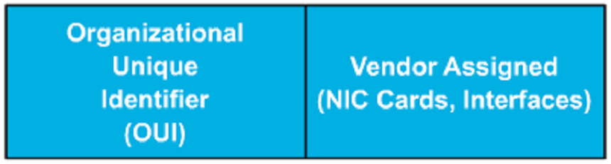
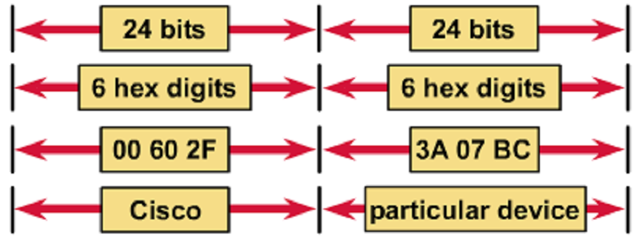
MAC address format
The remaining six hexadecimal digits comprise the interface serial number.
The first six hexadecimal digits, which are administered by the IEEE, identify the manufacturer or vendor.

Slide 14
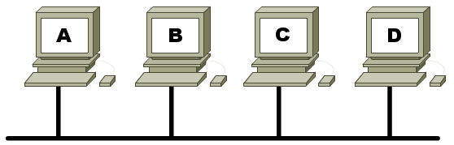
Using MAC addresses
Data
A
D
Data
A
D
Data
A
D
Data
A
D
Destination Address
Source Address
Notes:
At the data link layer MAC headers and trailers are added to upper layer data. The header and trailer contain control information intended for the data link layer in the destination system. Data from upper layer entities is encapsulated in the data link layer header and trailer.
The NIC uses the MAC address to assess whether the message should be passed onto the upper layers of the OSI model. The NIC makes this assessment without using CPU processing time, enabling better communication times on an Ethernet network.
On an Ethernet network, when one device sends data it can open a communication pathway to the other device by using the destination MAC address. The source device attaches a header with the MAC address of the intended destination and sends data onto the network. As this data propagates along the network media the NIC in each device on the network checks to see if the MAC address matches the physical destination address carried by the data frame. If there is no match, the NIC discards the data frame. When the data reaches the destination node, the NIC makes a copy and passes the frame up the OSI layers. On an Ethernet network, all nodes must examine the MAC header even if the communicating nodes are side by side.
All devices that are connected to the Ethernet LAN have MAC addressed interfaces including workstations, printers, routers, and switches.

Slide 15
Layer 2 framing : Why framing is necessary?
Which computers are communicating with one another.
When communication between individual computers begins and when it terminates.
A record of errors that occurred during the communication.
Whose turn it is to “talk” in a computer “conversation”.
Notes:
Encoded bit streams (data) on physical media represent a tremendous technological accomplishment, but they, alone, are not enough to make communication happen. Framing helps obtain essential information that could not, otherwise, be obtained with coded bit streams alone. Examples of such information are:
Which computers are communicating with one another
When communication between individual computers begins and when it terminates
Provides a method for detection of errors that occurred during the communication
Whose turn it is to "talk" in a computer "conversation"
Framing is the Layer 2 encapsulation process. A frame is the Layer 2 protocol data unit.

Slide 16
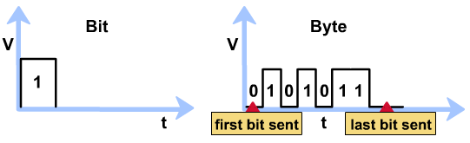
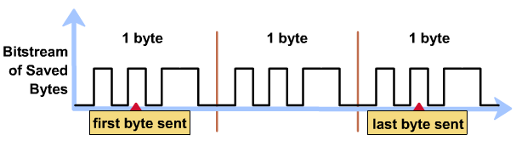
Frame format diagram
Notes:
A voltage vs. time graph could be used to visualize bits. However, when dealing with larger units of data, addressing and control information, a voltage vs. time graph could become large and confusing. Another type of diagram that could be used is the frame format diagram, which is based on voltage versus time graphs. Frame format diagrams are read from left to right, just like an oscilloscope graph. The frame format diagram shows different groupings of bits (fields) that perform other functions.

Slide 17
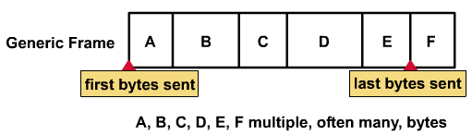
Frame format diagram
The frame format diagram shows different groupings of bits (fields) that perform other functions.
Read them from left to right.
Notes:
There are many different types of frames described by various standards. A single generic frame has sections called fields, and each field is composed of bytes. The names of the fields are as follows:
Start frame field
Address field
Length / type field
Data field
Frame check sequence field
When computers are connected to a physical medium, there must be a way they can grab the attention of other computers to broadcast the message, "Here comes a frame!" Various technologies have different ways of doing this process, but all frames, regardless of technology, have a beginning signaling sequence of bytes.
All frames contain naming information, such as the name of the source node (MAC address) and the name of the destination node (MAC address).
Most frames have some specialized fields. In some technologies, a length field specifies the exact length of a frame in bytes. Some frames have a type field, which specifies the Layer 3 protocol making the sending request.
The reason for sending frames is to get upper layer data, ultimately the user application data, from the source to the destination. The data package has two parts, the user application data and the encapsulated bytes to be sent to the destination computer. Padding bytes may be added so frames have a minimum length for timing purposes. Logical link control (LLC) bytes are also included with the data field in the IEEE standard frames. The LLC sub-layer takes the network protocol data, an IP packet, and adds control information to help deliver that IP packet to the destination node. Layer 2 communicates with the upper-level layers through LLC.
All frames and the bits, bytes, and fields contained within them, are susceptible to errors from a variety of sources. The Frame Check Sequence (FCS) field contains a number that is calculated by the source node based on the data in the frame. This FCS is then added to the end of the frame that is being sent. When the destination node receives the frame the FCS number is recalculated and compared with the FCS number included in the frame. If the two numbers are different, an error is assumed, the frame is discarded, and the source is asked to retransmit.
There are three primary ways to calculate the Frame Check Sequence number:
Cyclic Redundancy Check (CRC) – performs calculations on the data.
Two-dimensional parity – adds an 8th bit that makes an 8 bit sequence have an odd or even number of binary 1s.
Internet checksum – adds the values of all of the data bits to arrive at a sum.
The node that transmits data must get the attention of other devices, in order to start a frame, and to end the frame. The length field implies the end, and the frame is considered ended after the FCS. Sometimes there is a formal byte sequence referred to as an end-frame delimiter.

Slide 18
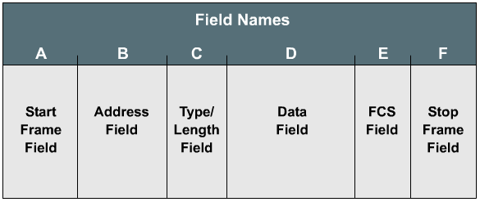
Generic frame format
There are many different types of frames described by various standards.

Slide 19
Start frame field
The Start Frame field tells other devices on the network that a frame is coming down the wire.

Slide 20
Address field
The Address field stores the source and destination MAC addresses.

Slide 21
Length/Type field
The Type/Length field is an optional field
Exact length of frame, or
Layer 3 protocol making the sending request, or
Not used

Slide 22
Data field
The Data field is the actual information being sent by the upper layer protocols. Therefore, it will be all upper layer data.

Slide 23
FCS field
Cyclic Redundancy Check (CRC) - performs polynomial calculations on the data
Two-dimensional parity - adds an 8th bit that makes an 8 bit sequence have an odd or even number of binary 1's
Internet checksum - adds the values of all of the data bits to arrive at a sum

Slide 24
Stop frame field
The Stop Frame field, also called the Frame Trailer, is an optional field that is used when the length of the frame was not specified in the Type/Length field.

Slide 25
Ethernet frame structure
Ethernet-II( DIX 2.0)
7+1 | 6 | 6 | 2 | 46-1500 | 4
Preamble | Dest. Address | Source Address | Type | Data | FCS
IEEE 802.3
7 | 1 | 6 | 6 | 2 | 64-1500 | 4
Preamble | Start Frame Delimiter | Dest. Address | Source Address | Length | 802.2 Header & Data | FCS
Notes:
At the data link layer the frame structure is nearly identical for all speeds of Ethernet from 10 Mbps to 10,000 Mbps. However, at the physical layer almost all versions of Ethernet are substantially different from one another with each speed having a distinct set of architecture design rules.
In the version of Ethernet that was developed by DIX prior to the adoption of the IEEE 802.3 version of Ethernet, the Preamble and Start Frame Delimiter (SFD) were combined into a single field, though the binary pattern was identical. The field labeled Length/Type was only listed as Length in the early IEEE versions and only as Type in the DIX version. These two uses of the field were officially combined in a later IEEE version, as both uses of the field were common throughout industry.
The Ethernet II Type field is incorporated into the current 802.3 frame definition. The receiving node must determine which higher-layer protocol is present in an incoming frame by examining the Length/Type field. If the two-octet value is equal to or greater than 0x600 (hexadecimal), then the frame is interpreted according to the Ethernet II type code indicated.
Some of the fields permitted or required in an 802.3 Ethernet Frame are:
Preamble
Start Frame Delimiter
Destination Address
Source Address
Length/Type
Data and Pad
FCS
Extension

Slide 26
Preamble Field
IEEE 802.3
7 | 1 | 6 | 6 | 2 | 64-1500 | 4
Preamble | Start Frame Delimiter | Dest. Address | Source Address | Length | 802.2 Header & Data | FCS
Preamble
  Alternating patterns of 1s and 0s, ended by 2 bits 11
  Tells receiving stations whether frame is Ethernet or IEEE 802.3
    Preamble + SOF(10101011) =Ethernet frame
Notes:
The Preamble is an alternating pattern of ones and zeroes used for timing synchronization in the asynchronous 10 Mbps and slower implementations of Ethernet. Faster versions of Ethernet are synchronous, and this timing information is redundant but retained for compatibility.
A Start Frame Delimiter consists of a one-octet field that marks the end of the timing information, and contains the bit sequence 10101011.
The Destination Address field contains the MAC destination address. The destination address can be unicast, multicast (group), or broadcast (all nodes).
The Source Address field contains the MAC source address. The source address is generally the unicast address of the transmitting Ethernet node. There are, however, an increasing number of virtual protocols in use that use and sometimes share a specific source MAC address to identify the virtual entity.
The Length/Type field supports two different uses. If the value is less than 1536 decimal, 0x600 (hexadecimal), then the value indicates length. The length interpretation is used where the LLC Layer provides the protocol identification. The type value specifies the upper-layer protocol to receive the data after Ethernet processing is completed. The length indicates the number of bytes of data that follows this field. If the value is equal to or greater than 1536 decimal (0600 hexadecimal), the value indicates that the type and contents of the Data field are decoded per the protocol indicated.
The Data and Pad field may be of any length that does not cause the frame to exceed the maximum frame size. The maximum transmission unit (MTU) for Ethernet is 1500 octets, so the data should not exceed that size. The content of this field is unspecified. An unspecified pad is inserted immediately after the user data when there is not enough user data for the frame to meet the minimum frame length. Ethernet requires that the frame be not less than 46 octets or more than 1518 octets.
A FCS contains a four byte CRC value that is created by the sending device and is recalculated by the receiving device to check for damaged frames. Since the corruption of a single bit anywhere from the beginning of the Destination Address through the end of the FCS field will cause the checksum to be different, the coverage of the FCS includes itself. It is not possible to distinguish between corruption of the FCS itself and corruption of any preceding field used in the calculation.

Slide 27
Start of Frame
IEEE 802.3
7 | 1 | 6 | 6 | 2 | 64-1500 | 4
Preamble | Start Frame Delimiter | Dest. Address | Source Address | Length | 802.2 Header & Data | FCS
Start of Frame
  IEEE 802.3 only
  Delimiter byte ends with 2 consecutive 1 bits
    Synchronize the frame-reception, ready to receive
  Explicitly specified in Ethernet

Slide 28
Address
IEEE 802.3
7 | 1 | 6 | 6 | 2 | 64-1500 | 4
Preamble | Start Frame Delimiter | Dest. Address | Source Address | Length | 802.2 Header & Data | FCS
Destination and source addresses
  1st 3 bytes are vendor-specific
    Specified by IEEE
  Last 3 bytes are specified by vendor
    Ethernet or IEEE 802.3 vendor
  Source address is always unicast
  Destination can be unicast, multicast, or broadcast

Slide 29
Type/Length
IEEE 802.3
7 | 1 | 6 | 6 | 2 | 64-1500 | 4
Preamble | Start Frame Delimiter | Dest. Address | Source Address | Length | 802.2 Header & Data | FCS
Type: DIX versions of Ethernet used, Specifies the upper-layer protocol to receive the data
Length: Early IEEE Ethernet versions used
If => 0x600 (hexadecimal), then the frame is interpreted according to the Ethernet II type code indicated.

Slide 30
Data - Ethernet
Ethernet-II( DIX 2.0)
7+1 | 6 | 6 | 2 | 46-1500 | 4
Preamble | Dest. Address | Source Address | Type | Data | FCS
Data—Ethernet
  At least 46 bytes of data
  Padding bytes inserted as needed

Slide 31
Data IEEE 802.3
IEEE 802.3
7 | 1 | 6 | 6 | 2 | 64-1500 | 4
Preamble | Start Frame Delimiter | Dest. Address | Source Address | Length | 802.2 Header & Data | FCS
Data—IEEE 802.3
  Upper-layer protocol destination is defined within the data portion of the frame (DSAP, SSAP, Control)
  At least 64 bytes
  Padding bytes inserted as needed

Slide 32
FCS
Ethernet-II( DIX 2.0)
7+1 | 6 | 6 | 2 | 46-1500 | 4
Preamble | Dest. Address | Source Address | Type | Data | FCS
Frame Check Sequence
  4 byte CRC value

Slide 33
ETHERNET OPERATION

Slide 34
Media Access Control (MAC)
Specified by the technology being used.
Determine who can transmit and when.
Two types:
  Deterministic: “Let’s take turns”.
    Token-Ring, FDDI.
  Non-deterministic: “First come, first serve”.
    Ethernet : CSMA/CD.
Notes:
MAC refers to protocols that determine which computer on a shared-medium environment, or collision domain, is allowed to transmit the data. MAC, with LLC, comprises the IEEE version of the OSI Layer 2. MAC and LLC are sublayers of Layer 2. There are two broad categories of Media Access Control, deterministic (taking turns) and non-deterministic (first come, first served).

Slide 35
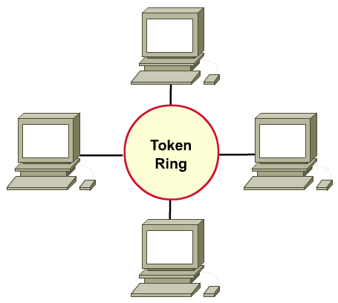
Deterministic MAC protocol

Slide 36

Non-deterministic MAC protocol
Carrier Sense Multiple Access with Collision Detection (CSMA/CD).

Slide 37
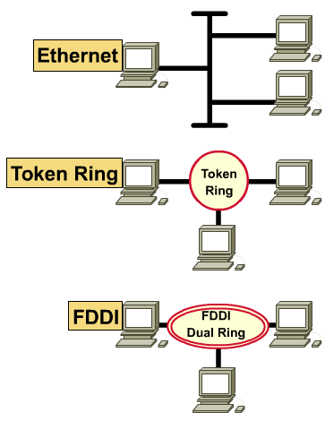
Three common Layer 2 technologies
Ethernet: logical broadcast topology
Token Ring: logical token ring topology
FDDI: logical token ring topology

Slide 38
MAC rules and collision detection/backoff
Ethernet is a shared-media broadcast technology. The access method CSMA/CD used in Ethernet performs three functions:
  Transmitting and receiving data packets
  Decoding data packets and checking them for valid addresses before passing them to the upper layers of the OSI model
  Detecting errors within data packets or on the network
Notes:
Ethernet is a shared-media broadcast technology. The access method CSMA/CD used in Ethernet performs three functions:
Transmitting and receiving data packets
Decoding data packets and checking them for valid addresses before passing them to the upper layers of the OSI model
Detecting errors within data packets or on the network

Slide 39
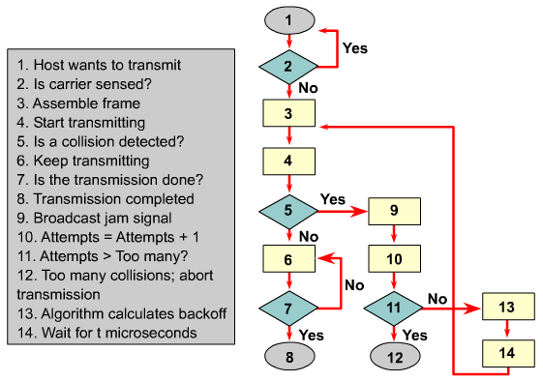
CSMA/CD Process
Notes:
In the CSMA/CD access method, networking devices with data to transmit work in a listen-before-transmit mode. This means when a node wants to send data, it must first check to see whether the networking media is busy. If the node determines the network is busy, the node will wait a random amount of time before retrying. If the node determines the networking media is not busy, the node will begin transmitting and listening. The node listens to ensure no other stations are transmitting at the same time. After completing data transmission the device will return to listening mode.
Networking devices detect a collision has occurred when the amplitude of the signal on the networking media increases. When a collision occurs, each node that is transmitting will continue to transmit for a short time to ensure that all devices see the collision. Once all the devices have detected the collision a backoff algorithm is invoked and transmission is stopped. The nodes stop transmitting for a random period of time, which is different for each device. When the delay period expires, all devices on the network can attempt to gain access to the networking media. When data transmission resumes on the network, the devices that were involved in the collision do not have priority to transmit data.

Slide 40
Ethernet timing
The electrical signal takes time to travel down the cable (delay), and each subsequent repeater.
Because of the delay and latency, it is possible for more than one station to begin transmitting at or near the same time. This results in a collision.
In full duplex collisions should not occur
→ eliminates the concept of slot time.
In half duplex, assuming that a collision does not occur, the 64 bits of preamble must be sent for timing synchronization first.
Notes:
The basic rules and specifications for proper operation of Ethernet are not particularly complicated, though some of the faster physical layer implementations are becoming so. Despite the basic simplicity, when a problem occurs in Ethernet it is often quite difficult to isolate the source. Because of the common bus architecture of Ethernet, also described as a distributed single point of failure, the scope of the problem usually encompasses all devices within the domain. In situations where repeaters are used, this can include devices up to four segments away.
Any station on an Ethernet network wishing to transmit a message first “listens” to ensure that no other station is currently transmitting. If the cable is quiet, the station will begin transmitting immediately. The electrical signal takes time to travel down the cable (delay), and each subsequent repeater introduces a small amount of latency in forwarding the frame from one port to the next. Because of the delay and latency, it is possible for more than one station to begin transmitting at or near the same time. This results in a collision.
If the attached station is operating in full duplex then the station may send and receive simultaneously and collisions should not occur. Full-duplex operation also changes the timing considerations and eliminates the concept of slot time. Full-duplex operation allows for larger network architecture designs since the timing restriction for collision detection is removed.
In half duplex, assuming that a collision does not occur, the sending station will transmit 64 bits of timing synchronization information that is known as the preamble. The sending station will then transmit the following information:
Destination and source MAC addressing information
Certain other header information
The actual data payload
Checksum (FCS) used to ensure that the message was not corrupted along the way
Stations receiving the frame recalculate the FCS to determine if the incoming message is valid and then pass valid messages to the next higher layer in the protocol stack.

Slide 41
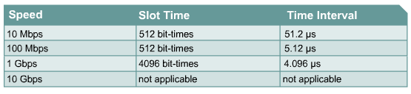
Ethernet timing
10 Mbps and slower versions of Ethernet are asynchronous.
100 Mbps and higher speed implementations of Ethernet are synchronous.
For all speeds of Ethernet transmission at or below 1000 Mbps, the standard describes how a transmission may be no smaller than the slot time.
Notes:
10 Mbps and slower versions of Ethernet are asynchronous. Asynchronous means that each receiving station will use the eight octets of timing information to synchronize the receive circuit to the incoming data, and then discard it. 100 Mbps and higher speed implementations of Ethernet are synchronous. Synchronous means the timing information is not required, however for compatibility reasons the Preamble and SFD are present.
For all speeds of Ethernet transmission at or below 1000 Mbps, the standard describes how a transmission may be no smaller than the slot time. Slot time for 10 and 100-Mbps Ethernet is 512 bit-times, or 64 octets. Slot time for 1000-Mbps Ethernet is 4096 bit-times, or 512 octets. Slot time is calculated assuming maximum cable lengths on the largest legal network architecture. All hardware propagation delay times are at the legal maximum and the 32-bit jam signal is used when collisions are detected.
The actual calculated slot time is just longer than the theoretical amount of time required to travel between the furthest points of the collision domain, collide with another transmission at the last possible instant, and then have the collision fragments return to the sending station and be detected. For the system to work the first station must learn about the collision before it finishes sending the smallest legal frame size. To allow 1000-Mbps Ethernet to operate in half duplex the extension field was added when sending small frames purely to keep the transmitter busy long enough for a collision fragment to return. This field is present only on 1000-Mbps, half-duplex links and allows minimum-sized frames to be long enough to meet slot time requirements. Extension bits are discarded by the receiving station.

Slide 42
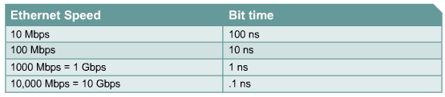
Ethernet timing
Notes:
On 10-Mbps Ethernet one bit at the MAC layer requires 100 nanoseconds (ns) to transmit. At 100 Mbps that same bit requires 10 ns to transmit and at 1000 Mbps only takes 1 ns. As a rough estimate, 20.3 cm (8 in) per nanosecond is often used for calculating propagation delay down a UTP cable. For 100 meters of UTP, this means that it takes just under 5 bit-times for a 10BASE-T signal to travel the length the cable.
For CSMA/CD Ethernet to operate, the sending station must become aware of a collision before it has completed transmission of a minimum-sized frame. At 100 Mbps the system timing is barely able to accommodate 100 meter cables. At 1000 Mbps special adjustments are required as nearly an entire minimum-sized frame would be transmitted before the first bit reached the end of the first 100 meters of UTP cable. For this reason half duplex is not permitted in 10-Gigabit Ethernet.

Slide 43
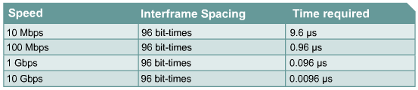
Interframe spacing
The minimum spacing between two non-colliding frames is also called the interframe spacing.
Spacing gap.
Notes:
The minimum spacing between two non-colliding frames is also called the interframe spacing. This is measured from the last bit of the FCS field of the first frame to the first bit of the preamble of the second frame.
After a frame has been sent, all stations on a 10-Mbps Ethernet are required to wait a minimum of 96 bit-times (9.6 microseconds) before any station may legally transmit the next frame. On faster versions of Ethernet the spacing remains the same, 96 bit-times, but the time required for that interval grows correspondingly shorter. This interval is referred to as the spacing gap. The gap is intended to allow slow stations time to process the previous frame and prepare for the next frame.
A repeater is expected to regenerate the full 64 bits of timing information, which is the preamble and SFD, at the start of any frame. This is despite the potential loss of some of the beginning preamble bits because of slow synchronization. Because of this forced reintroduction of timing bits, some minor reduction of the interframe gap is not only possible but expected. Some Ethernet chipsets are sensitive to a shortening of the interframe spacing, and will begin failing to see frames as the gap is reduced. With the increase in processing power at the desktop, it would be very easy for a personal computer to saturate an Ethernet segment with traffic and to begin transmitting again before the interframe spacing delay time is satisfied.

Slide 44
Backoff algorithm
Backoff is the process by which a transmitting interface determines how long to wait following a collision before attempting to retransmit the frame.
All transmitting interface then stop sending for a backoff time (randomly 0 .. 2n - 1 of 51.2ms).
The range continues to expand until after 10 attempts it reaches 0 to 1023.
unsuccessful after 16 attempts, the MAC function reports an excessive collision error.
Notes:
Backoff
Backoff is the process by which a transmitting interface determines how long to wait following a collision before attempting to retransmit the frame. If all interfaces waited the same length of time before retransmission, then another collision would inevitably occur. This is avoided by having each interface generate a random number which determines the length of time it must wait before testing the carrier. The backoff algorithm implemented in Ethernet is officially known as truncated binary exponential backoff. Following a collision, each interface generates a random number that falls within a specified range of values and then waits that number of slot times before attempting retransmission. The range of values increases exponentially after each failed attempt. For the first attempt the range is 0 to 1; for the second attempt, 0 to 3; for the third, 0 to 7 and so on. If repeated collisions occur, the range continues to expand until after 10 attempts it reaches 0 to 1023. If an interface is unsuccessful after 16 attempts, the MAC function reports an excessive collision error.

Slide 45
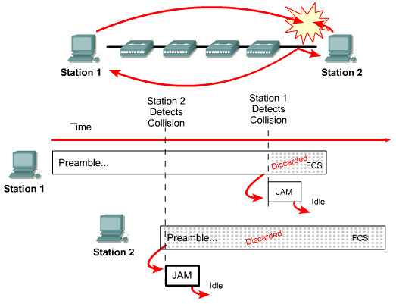
Error handling: Collision
The corrupted, partially transmitted messages are often referred to as collision fragments or runts.
Notes:
The most common error condition on an Ethernet is the collision. Collisions are the mechanism for resolving contention for network access. A few collisions provide a smooth, simple, low overhead way for network nodes to arbitrate contention for the network resource. When network contention becomes too great, collisions can become a significant impediment to useful network operation.
Collisions result in network bandwidth loss that is equal to the initial transmission and the collision jam signal. This is consumption delay and affects all network nodes possibly causing significant reduction in network throughput.
The considerable majority of collisions occur very early in the frame, often before the SFD. Collisions occurring before the SFD are usually not reported to the higher layers, as if the collision did not occur. As soon as a collision is detected, the sending stations transmit a 32-bit “jam” signal that will enforce the collision. This is done so that any data being transmitted is thoroughly corrupted and all stations have a chance to detect the collision.
In Figure two stations listen to ensure that the cable is idle, then transmit. Station 1 was able to transmit a significant percentage of the frame before the signal even reached the last cable segment. Station 2 had not received the first bit of the transmission prior to beginning its own transmission and was only able to send several bits before the NIC sensed the collision. Station 2 immediately truncated the current transmission, substituted the 32-bit jam signal and ceased all transmissions. During the collision and jam event that Station 2 was experiencing, the collision fragments were working their way back through the repeated collision domain toward Station 1. Station 2 completed transmission of the 32-bit jam signal and became silent before the collision propagated back to Station 1 which was still unaware of the collision and continued to transmit. When the collision fragments finally reached Station 1, it also truncated the current transmission and substituted a 32-bit jam signal in place of the remainder of the frame it was transmitting. Upon sending the 32-bit jam signal Station 1 ceased all transmissions.
A jam signal may be composed of any binary data so long as it does not form a proper checksum for the portion of the frame already transmitted. The most commonly observed data pattern for a jam signal is simply a repeating one, zero, one, zero pattern, the same as Preamble. When viewed by a protocol analyzer this pattern appears as either a repeating hexadecimal 5 or A sequence. The corrupted, partially transmitted messages are often referred to as collision fragments or runts. Normal collisions are less than 64 octets in length and therefore fail both the minimum length test and the FCS checksum test.

Slide 46
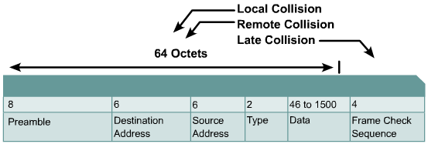
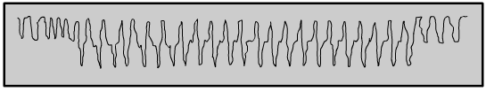
Types of collisions
Notes:
Collisions typically take place when two or more Ethernet stations transmit simultaneously within a collision domain. A single collision is a collision that was detected while trying to transmit a frame, but on the next attempt the frame was transmitted successfully. Multiple collisions indicate that the same frame collided repeatedly before being successfully transmitted. The results of collisions, collision fragments, are partial or corrupted frames that are less than 64 octets and have an invalid FCS. Three types of collisions are:
Local
Remote
Late
To create a local collision on coax cable (10BASE2 and 10BASE5), the signal travels down the cable until it encounters a signal from the other station. The waveforms then overlap, canceling some parts of the signal out and reinforcing or doubling other parts. The doubling of the signal pushes the voltage level of the signal beyond the allowed maximum. This over-voltage condition is then sensed by all of the stations on the local cable segment as a collision.
In the beginning the waveform in Figure represents normal Manchester encoded data. A few cycles into the sample the amplitude of the wave doubles. That is the beginning of the collision, where the two waveforms are overlapping. Just prior to the end of the sample the amplitude returns to normal. This happens when the first station to detect the collision quits transmitting, and the jam signal from the second colliding station is still observed.
On UTP cable, such as 10BASE-T, 100BASE-TX and 1000BASE-T, a collision is detected on the local segment only when a station detects a signal on the RX pair at the same time it is sending on the TX pair. Since the two signals are on different pairs there is no characteristic change in the signal. Collisions are only recognized on UTP when the station is operating in half duplex. The only functional difference between half and full duplex operation in this regard is whether or not the transmit and receive pairs are permitted to be used simultaneously. If the station is not engaged in transmitting it cannot detect a local collision. Conversely, a cable fault such as excessive crosstalk can cause a station to perceive its own transmission as a local collision.
The characteristics of a remote collision are a frame that is less than the minimum length, has an invalid FCS checksum, but does not exhibit the local collision symptom of over-voltage or simultaneous RX/TX activity. This sort of collision usually results from collisions occurring on the far side of a repeated connection. A repeater will not forward an over-voltage state, and cannot cause a station to have both the TX and RX pairs active at the same time. The station would have to be transmitting to have both pairs active, and that would constitute a local collision. On UTP networks this is the most common sort of collision observed.
There is no possibility remaining for a normal or legal collision after the first 64 octets of data has been transmitted by the sending stations. Collisions occurring after the first 64 octets are called “late collisions". The most significant difference between late collisions and collisions occurring before the first 64 octets is that the Ethernet NIC will retransmit a normally collided frame automatically, but will not automatically retransmit a frame that was collided late. As far as the NIC is concerned everything went out fine, and the upper layers of the protocol stack must determine that the frame was lost. Other than retransmission, a station detecting a late collision handles it in exactly the same way as a normal collision.

Slide 47
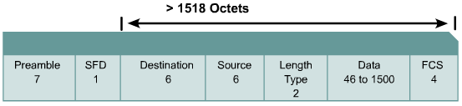

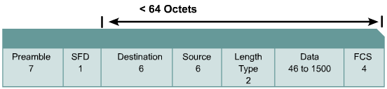

Ethernet errors
Notes:
Knowledge of typical errors is invaluable for understanding both the operation and troubleshooting of Ethernet networks. The following are the sources of Ethernet error:
Collision or runt – Simultaneous transmission occurring before slot time has elapsed
Late collision – Simultaneous transmission occurring after slot time has elapsed
Jabber, long frame and range errors – Excessively or illegally long transmission
Short frame, collision fragment or runt – Illegally short transmission
FCS error – Corrupted transmission
Alignment error – Insufficient or excessive number of bits transmitted
Range error – Actual and reported number of octets in frame do not match
Ghost or jabber – Unusually long Preamble or Jam event
While local and remote collisions are considered to be a normal part of Ethernet operation, late collisions are considered to be an error. The presence of errors on a network always suggests that further investigation is warranted. The severity of the problem indicates the troubleshooting urgency related to the detected errors. A handful of errors detected over many minutes or over hours would be a low priority. Thousands detected over a few minutes suggest that urgent attention is warranted.
Jabber is defined in several places in the 802.3 standard as being a transmission of at least 20,000 to 50,000 bit times in duration. However, most diagnostic tools report jabber whenever a detected transmission exceeds the maximum legal frame size, which is considerably smaller than 20,000 to 50,000 bit times. Most references to jabber are more properly called long frames.
A long frame is one that is longer than the maximum legal size, and takes into consideration whether or not the frame was tagged. It does not consider whether or not the frame had a valid FCS checksum. This error usually means that jabber was detected on the network.
A short frame is a frame smaller than the minimum legal size of 64 octets, with a good frame check sequence. Some protocol analyzers and network monitors call these frames “runts". In general the presence of short frames is not a guarantee that the network is failing.
The term runt is generally an imprecise slang term that means something less than a legal frame size. It may refer to short frames with a valid FCS checksum although it usually refers to collision fragments.

Slide 48
Ethernet errors
The following are the sources of Ethernet error:
Collision or runt – Simultaneous transmission occurring before slot time has elapsed
Late collision – Simultaneous transmission occurring after slot time has elapsed
Jabber, long frame and range errors – Excessively or illegally long transmission
Short frame, collision fragment or runt – Illegally short transmission
FCS error – Corrupted transmission
Alignment error – Insufficient or excessive number of bits transmitted
Range error – Actual and reported number of octets in frame do not match
Ghost or jabber – Unusually long Preamble or Jam event

Slide 49
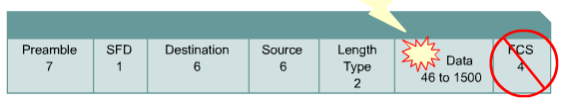
FCS and beyond
High numbers of FCS errors from a single station usually indicates a faulty NIC and/or faulty or corrupted software drivers, or a bad cable connecting that station to the network.
If FCS errors are associated with many stations, they are generally traceable to bad cabling, a faulty version of the NIC driver, a faulty hub port, or induced noise in the cable system.
Notes:
A received frame that has a bad Frame Check Sequence, also referred to as a checksum or CRC error, differs from the original transmission by at least one bit. In an FCS error frame the header information is probably correct, but the checksum calculated by the receiving station does not match the checksum appended to the end of the frame by the sending station. The frame is then discarded. High numbers of FCS errors from a single station usually indicates a faulty NIC and/or faulty or corrupted software drivers, or a bad cable connecting that station to the network. If FCS errors are associated with many stations, they are generally traceable to bad cabling, a faulty version of the NIC driver, a faulty hub port, or induced noise in the cable system.

Slide 50
FCS and beyond: Alignment error
A message that does not end on an octet boundary is known as an alignment error.
Such a frame is truncated to the nearest octet boundary, and if the FCS checksum fails, then an alignment error is reported.
This is often caused by bad software drivers, or a collision, and is frequently accompanied by a failure of the FCS checksum.
Notes:
A message that does not end on an octet boundary is known as an alignment error. Instead of the correct number of binary bits forming complete octet groupings, there are additional bits left over (less than eight). Such a frame is truncated to the nearest octet boundary, and if the FCS checksum fails, then an alignment error is reported. This is often caused by bad software drivers, or a collision, and is frequently accompanied by a failure of the FCS checksum.

Slide 51
FCS and beyond: Range error
A frame with a valid value in the Length field but did not match the actual number of octets counted in the data field of the received frame is known as a range error.
This error also appears when the length field value is less than the minimum legal unpadded size of the data field. A similar error, Out of Range, is reported when the value in the Length field indicates a data size that is too large to be legal.
Notes:
A frame with a valid value in the Length field but did not match the actual number of octets counted in the data field of the received frame is known as a range error. This error also appears when the length field value is less than the minimum legal unpadded size of the data field. A similar error, Out of Range, is reported when the value in the Length field indicates a data size that is too large to be legal.

Slide 52
FCS and beyond: Ghost
Term ghost to mean energy (noise) detected on the cable that appears to be a frame, but is lacking a valid SFD.
To qualify as a ghost, the frame must be at least 72 octets long, including the preamble. Otherwise, it is classified as a remote collision.
Ground loops and other wiring problems are usually the cause of ghosting.
Most network monitoring tools do not recognize the existence of ghosts for the same reason that they do not recognize preamble collisions.
Notes:
Fluke Networks has coined the term ghost to mean energy (noise) detected on the cable that appears to be a frame, but is lacking a valid SFD. To qualify as a ghost, the frame must be at least 72 octets long, including the preamble. Otherwise, it is classified as a remote collision. Because of the peculiar nature of ghosts, it is important to note that test results are largely dependent upon where on the segment the measurement is made.
Ground loops and other wiring problems are usually the cause of ghosting. Most network monitoring tools do not recognize the existence of ghosts for the same reason that they do not recognize preamble collisions. The tools rely entirely on what the chipset tells them. Software-only protocol analyzers, many hardware-based protocol analyzers, hand held diagnostic tools, as well as most remote monitoring (RMON) probes do not report these events.

Slide 53
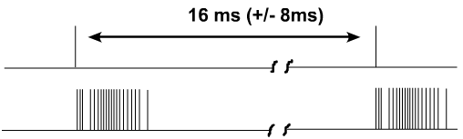
Ethernet auto-negotiation
A process called Auto-Negotiation of speeds at half or full duplex was developed to make each technology interoperable
Defines how two link partners may automatically negotiate a configuration offering the best common performance level.
Notes:
As Ethernet grew from 10 to 100 and 1000 Mbps, one requirement was to make each technology interoperable, even to the point that 10, 100, and 1000 interfaces could be directly connected. A process called Auto-Negotiation of speeds at half or full duplex was developed. Specifically, at the time that Fast Ethernet was introduced, the standard included a method of automatically configuring a given interface to match the speed and capabilities of the link partner. This process defines how two link partners may automatically negotiate a configuration offering the best common performance level. It has the additional advantage of only involving the lowest part of the physical layer.
10BASE-T required each station to transmit a link pulse about every 16 milliseconds, whenever the station was not engaged in transmitting a message. Auto-Negotiation adopted this signal and renamed it a Normal Link Pulse (NLP). When a series of NLPs are sent in a group for the purpose of Auto-Negotiation, the group is called a Fast Link Pulse (FLP) burst. Each FLP burst is sent at the same timing interval as an NLP, and is intended to allow older 10BASE-T devices to operate normally in the event they should receive an FLP burst.
Auto-Negotiation is accomplished by transmitting a burst of 10BASE-T Link Pulses from each of the two link partners. The burst communicates the capabilities of the transmitting station to its link partner. After both stations have interpreted what the other partner is offering, both switch to the highest performance common configuration and establish a link at that speed. If anything interrupts communications and the link is lost, the two link partners first attempt to link again at the last negotiated speed. If that fails, or if it has been too long since the link was lost, the Auto-Negotiation process starts over. The link may be lost due to external influences, such as a cable fault, or due to one of the partners issuing a reset.

Slide 54
Link establishment and full and half duplex
1000BASE-T full duplex ←→ 1000BASE-T full duplex
1000BASE-T half duplex ←→ 1000BASE-T half duplex
100BASE-TX full duplex ←→ 100BASE-TX full duplex
100BASE-TX half duplex ←→ 100BASE-TX half duplex
10BASE-T full duplex ←→ 10BASE-T full duplex
10BASE-T half duplex ←→ 10BASE-T half duplex
Notes:
Link partners are allowed to skip offering configurations of which they are capable. This allows the network administrator to force ports to a selected speed and duplex setting, without disabling Auto-Negotiation. Auto-Negotiation is optional for most Ethernet implementations. Gigabit Ethernet requires its implementation, though the user may disable it. Auto-Negotiation was originally defined for UTP implementations of Ethernet and has been extended to work with other fiber optic implementations.
When an Auto-Negotiating station first attempts to link it is supposed to enable 100BASE-TX to attempt to immediately establish a link. If 100BASE-TX signaling is present, and the station supports 100BASE-TX, it will attempt to establish a link without negotiating. If either signaling produces a link or FLP bursts are received, the station will proceed with that technology. If a link partner does not offer an FLP burst, but instead offers NLPs, then that device is automatically assumed to be a 10BASE-T station. During this initial interval of testing for other technologies, the transmit path is sending FLP bursts. The standard does not permit parallel detection of any other technologies.
If a link is established through parallel detection, it is required to be half duplex. There are only two methods of achieving a full-duplex link. One method is through a completed cycle of Auto-Negotiation, and the other is to administratively force both link partners to full duplex. If one link partner is forced to full duplex, but the other partner attempts to Auto-Negotiate, then there is certain to be a duplex mismatch. This will result in collisions and errors on that link. Additionally if one end is forced to full duplex the other must also be forced. The exception to this is 10-Gigabit Ethernet, which does not support half duplex.
Many vendors implement hardware in such a way that it cycles through the various possible states. It transmits FLP bursts to Auto-Negotiate for a while, then it configures for Fast Ethernet, attempts to link for a while, and then just listens. Some vendors do not offer any transmitted attempt to link until the interface first hears an FLP burst or some other signaling scheme.
There are two duplex modes, half and full. For shared media, the half-duplex mode is mandatory. All coaxial implementations are half duplex in nature and cannot operate in full duplex. UTP and fiber implementations may be operated in half duplex. 10-Gbps implementations are specified for full duplex only.
In half duplex only one station may transmit at a time. For the coaxial implementations a second station transmitting will cause the signals to overlap and become corrupted. Since UTP and fiber generally transmit on separate pairs the signals have no opportunity to overlap and become corrupted. Ethernet has established arbitration rules for resolving conflicts arising from instances when more than one station attempts to transmit at the same time. Both stations in a point-to-point full-duplex link are permitted to transmit at any time, regardless of whether the other station is transmitting.
Auto-Negotiation avoids most situations where one station in a point-to-point link is transmitting under half-duplex rules and the other under full-duplex rules.
In the event that link partners are capable of sharing more than one common technology, refer to the list in Figure . This list is used to determine which technology should be chosen from the offered configurations.
Fiber-optic Ethernet implementations are not included in this priority resolution list because the interface electronics and optics do not permit easy reconfiguration between implementations. It is assumed that the interface configuration is fixed. If the two interfaces are able to Auto-Negotiate then they are already using the same Ethernet implementation. However, there remain a number of configuration choices such as the duplex setting, or which station will act as the Master for clocking purposes, that must be determined.

Slide 55

Summary
The basics of Ethernet technology
The naming rules of Ethernet technology
How Ethernet and the OSI model interact
Ethernet framing process and frame structure
Ethernet frame field names and purposes
The characteristics and function of CSMA/CD
Ethernet timing
Interframe spacing
The backoff algorithm and time after a collision
Ethernet errors and collisions
Auto-negotiation in relation to speed and duplex

Slide 56

Q&A
Notes:
_________________________________________________________________________
_________________________________________________________________________
_________________________________________________________________________
_________________________________________________________________________
_________________________________________________________________________
_________________________________________________________________________
_________________________________________________________________________
_________________________________________________________________________
_________________________________________________________________________
_________________________________________________________________________
_________________________________________________________________________
_________________________________________________________________________
_________________________________________________________________________
_________________________________________________________________________
_________________________________________________________________________
_________________________________________________________________________
_________________________________________________________________________
_________________________________________________________________________
_________________________________________________________________________

Slide 57
Enjoy the Course
Notes:
_________________________________________________________________________
_________________________________________________________________________
_________________________________________________________________________
_________________________________________________________________________
_________________________________________________________________________
_________________________________________________________________________
_________________________________________________________________________
_________________________________________________________________________
_________________________________________________________________________
_________________________________________________________________________
_________________________________________________________________________
_________________________________________________________________________
_________________________________________________________________________
_________________________________________________________________________
_________________________________________________________________________
_________________________________________________________________________
_________________________________________________________________________
_________________________________________________________________________
_________________________________________________________________________

